Slide 1
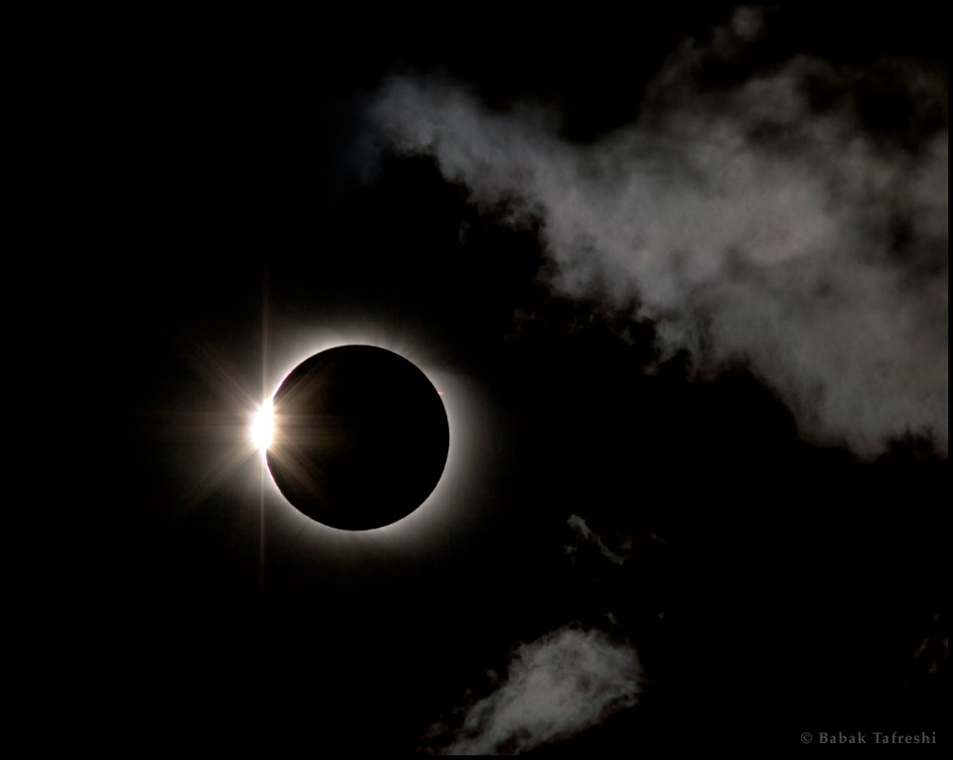

OBSCURATION TOTALITY
Brandon Wilson

Slide 2
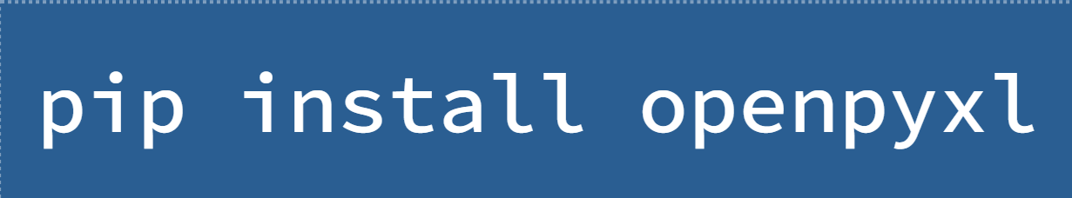
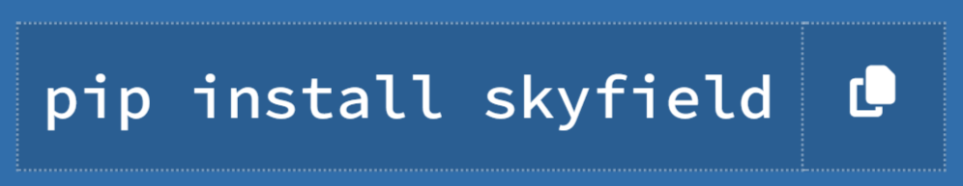
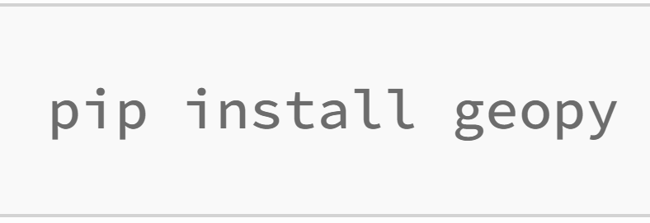
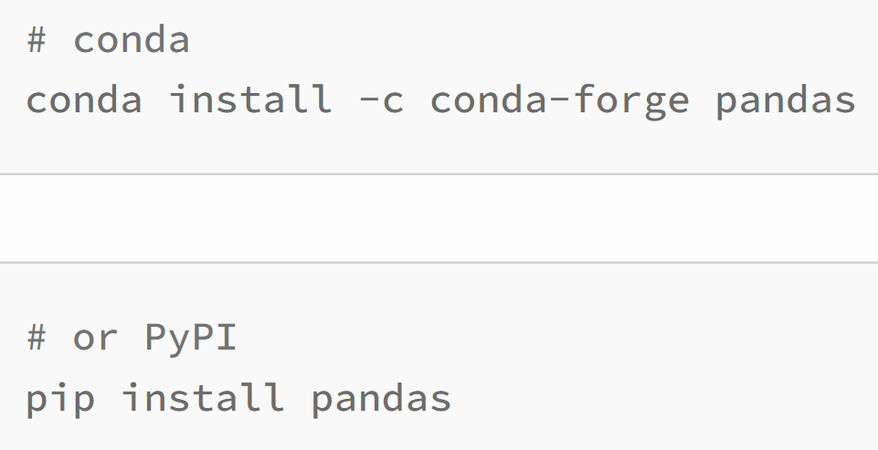
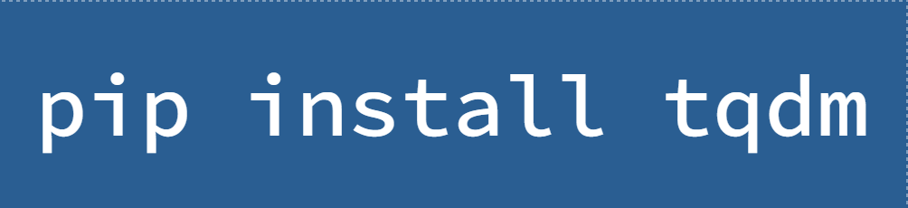
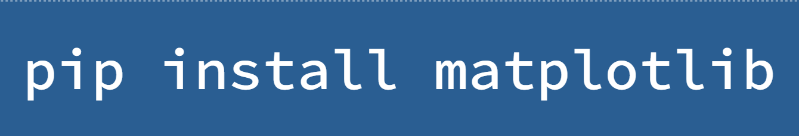
ALL PYTHON PACKAGES UTILIZED:
Skyfield - Skyfield is a pure-Python astronomy package that is compatible with both Python 2 and 3 and makes it easy to generate high precision research-grade positions for planets and Earth satellites.
Openpyxl - Python library to read/write Excel xlsx/xlsm/xltx/xltm files
Geopy - Python client for several popular geocoding web services
Pandas - Python package that provides fast, flexible, and expressive data structures designed to make working with “relational” or “labeled” data both east and intuitive
tqdm - Python package that instantly makes loops show a smart progress meter
matplotlib - Python comprehensive library for creating static, animates, and interactive visualizations in Python
Math - Built-in Python library made to simplify mathematical tasks in Python
Datetime - Built-in Python package that contains capacities and classes for working with dates, times, and timezones

Slide 3
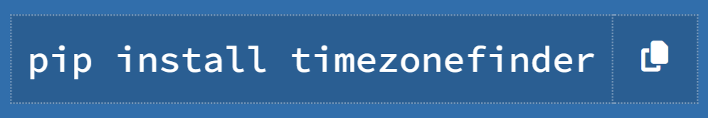
ALL PYTHON PACKAGES UTILIZED: continued…
ZoneInfo – built-in Python module provides a concrete time zone implementation to support the IANA time zone database
timezonefinder - Built-in Python library made to simplify mathematical tasks in Python

Slide 4
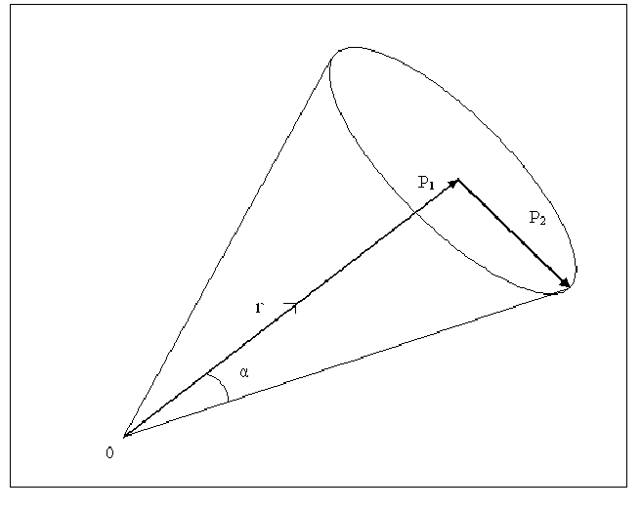
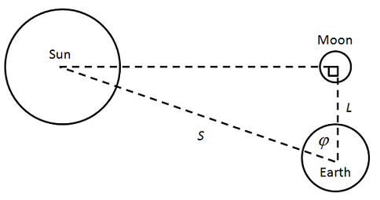
CALCULATING OBSCURATION…
Obscuration - the fraction of the Sun’s surface area covered by the Moon
Obscuration Simulation
Calculate the Angular Radii
Distance between Sun and the Moon
If the Distance ≥ the Sum of the Sun and Moon’s angular radii, NO obscuration.
If the Distance ≤ the absolute difference of their radii, obscuration OCCURS.

Slide 5
PATH OF ECLIPSE (April 8th, 2024)…

Slide 6
FILE ACCESS & EXPLANATION:
Obscuration Totality - Access

Slide 7
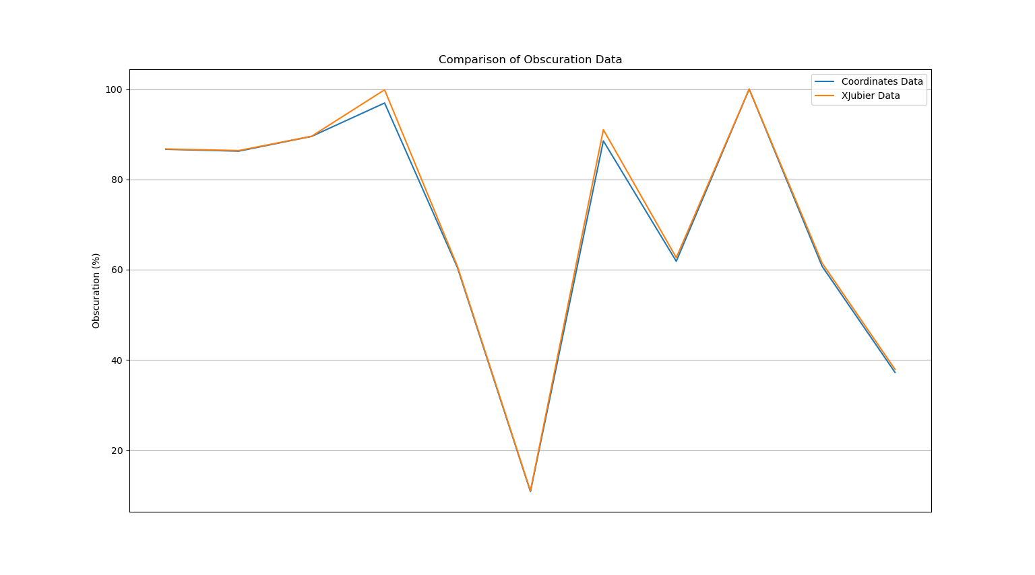
MAX OBSCURATION DATA ANALYSIS:
LINE GRAPH COMPARISON: ACCURACY
XJubier Data – Accurate (max obscuration) solar eclipse data from Google Maps – Interactive Maps for Solar Eclipses, developed by Xavier Jubier, mapping expert
Coordinates Data – Data calculated in maxObscuration.py

